Slide 1
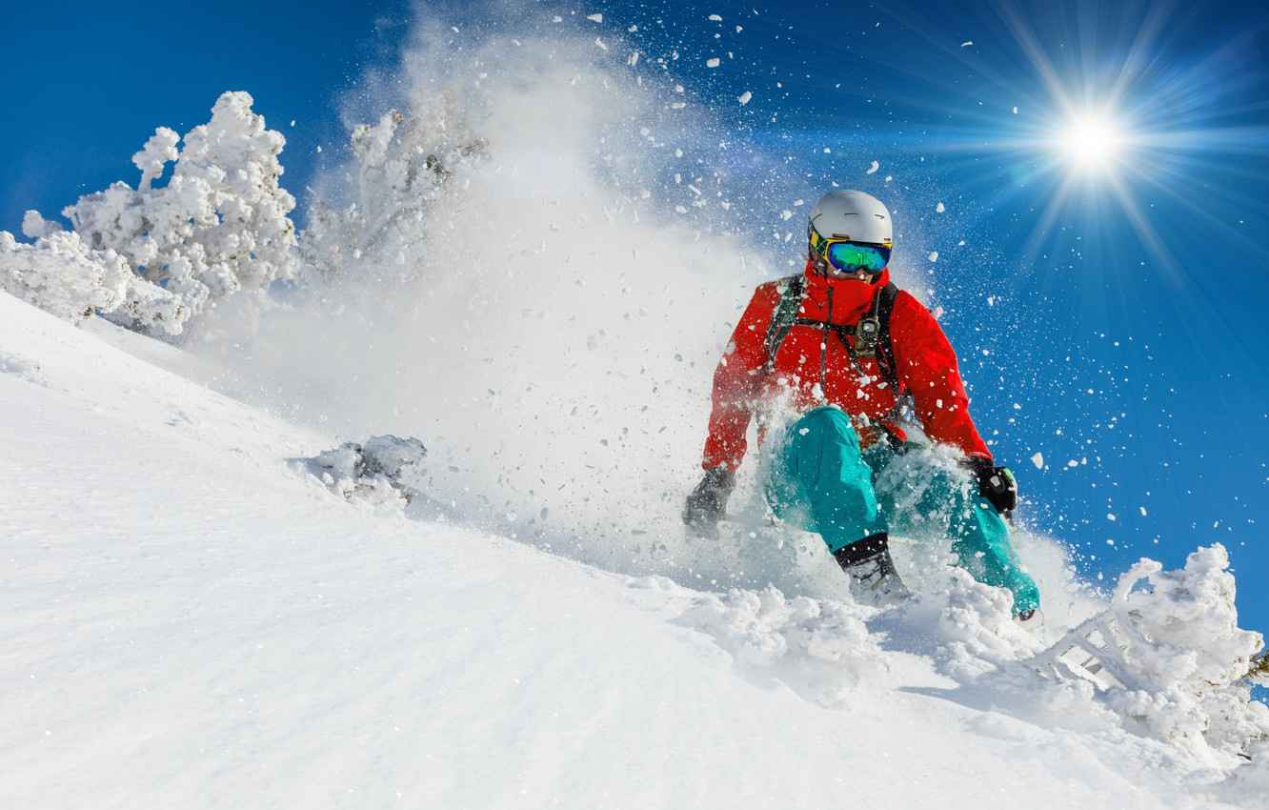
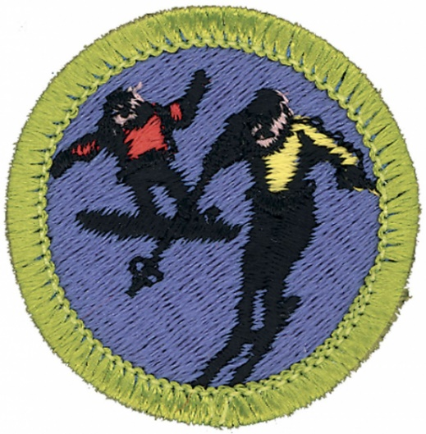
Snowshoeing Option
Troop 344 and 9344
Pemberville, OH
Snow Sports Merit Badge

Slide 2
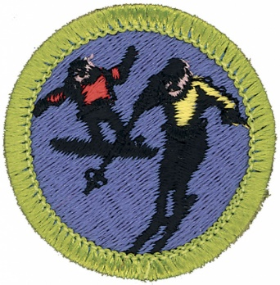
Snow Sports
Do the following:
  Explain to your counselor the hazards you are most likely to encounter while participating in snow sport activities, and what you should do to anticipate, help prevent, mitigate, and respond to these hazards.
  Discuss first aid and prevention for the types of injuries or illnesses that could occur while participating in snow sports, including hypothermia, frostbite, shock, dehydration, sunburn, concussion, fractures, bruises, sprains, and strains. Tell how to apply splints.
Do the following:
  Explain why every snow sport participant should be prepared to render first aid in the event of an accident.
  Explain the procedure used to report an accident to the local ski patrol or local emergency personnel.
Explain the international trail-marking system.
Discuss the importance of strength, endurance, and flexibility in snow sports. Demonstrate exercises and activities you can do to get fit for the option you choose in requirement 7.
Present yourself properly clothed and equipped for the option you choose in requirement 7. Discuss how the clothing you have chosen will help keep you warm and protected.

Slide 3
Snow Sports
Do EACH of the following:
  Tell the meaning of the Your Responsibility Code for skiers snow-boarders, and snowshoers. Explain why each rider must follow this code.
  Explain the Smart Style safety program. Tell why it is important and how it applies to participants at snow sport venues in terrain parks and pipes.
  Explain the precautions pertaining to avalanche safety, including the responsibility of individuals regarding avalanche safety.
Complete ALL of the requirements for ONE of the following options: downhill (Alpine) skiing OR cross-country (Nordic) OR snowboarding OR snowshoeing**.
**This presentation only addresses the snowshoeing requirements.

Slide 4
Snow Sports
Complete all of the requirements for Snowshoeing
  Name the parts of a snowshoe.
  Explain how to choose the correct size of snowshoe.
  Describe the different types of snowshoes and their specialized uses. Discuss factors to consider when choosing a snowshoe.
  Explain how to properly care for and maintain snowshoes.
  List the items you would take on a one-day snowshoe hike.
  Describe areas that are best for snowshoeing. Discuss some advantages and dangers of backcountry snowshoeing.
  Discuss the benefits of snowshoeing.
  Demonstrate the most efficient ways to break trail, climb uphill, travel downhill and traverse a slope.
  Demonstrate your ability, on a 2-mile snowshoe hike, to cope with an average variety of snow conditions .
  Demonstrate the proper use of a topographic map and compass.

Slide 5
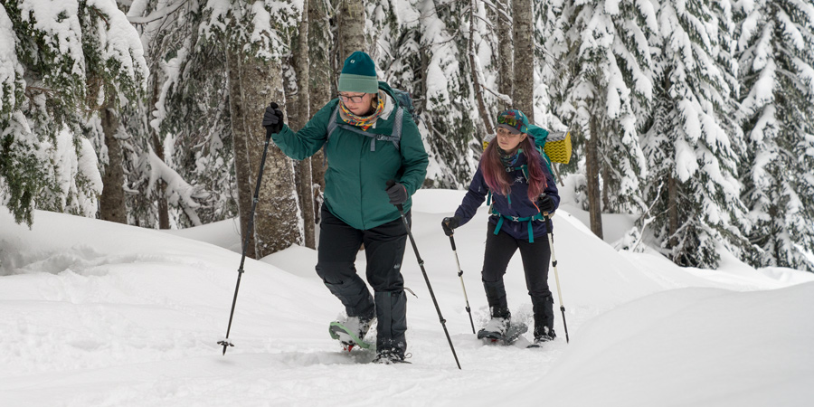
Snow Sports

Slide 6
Winter Sports Safety and First Aid
Most of this is covered by the First Aid Merit Badge
Do the following:
  Explain to your counselor the hazards you are most likely to encounter while participating in snow sport activities, and what you should do to anticipate, help prevent, mitigate, and respond to these hazards.
  Discuss first aid and prevention for the types of injuries or illnesses that could occur while participating in snow sports, including hypothermia, frostbite, shock, dehydration, sunburn, concussion, fractures, bruises, sprains, and strains. Tell how to apply splints.
Do the following:
  Explain why every snow sport participant should be prepared to render first aid in the event of an accident.
  Explain the procedure used to report an accident to the local ski patrol for the area where you usually ski, ride, or snowshoe.

Slide 7
Winter Sports Safety
Be sure your winter outdoor activities always follow these guidelines:
All winter activities must be supervised by mature and conscientious adults (at least one of whom must be age 21 or older) who understand and knowingly accept responsibility for the well-being and safety of the youth in their care.
Winter sports activities embody intrinsic hazards that vary from sport to sport. Participants should be aware of the potential hazards of any winter sport before engaging in it.
Appropriate personal protective equipment is required for all activities. The use of helmets is required for the following activities: downhill skiing, snowboarding and operating snowmobiles (requires full face helmets).

Slide 8
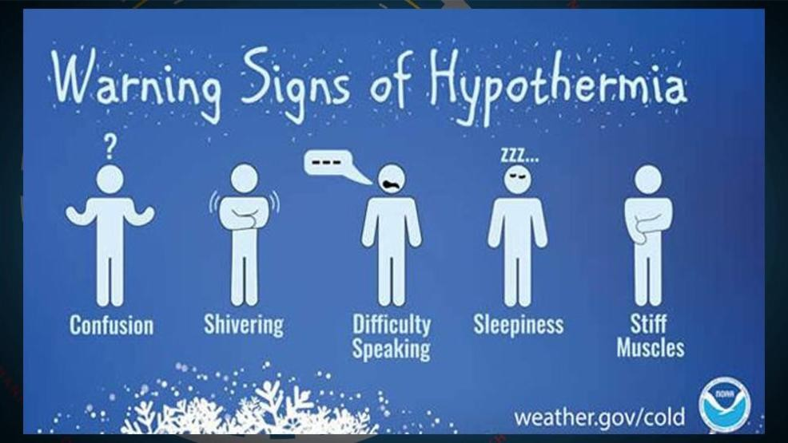

Slide 9
Hypothermia
It is important to recognize hypothermia and treat it promptly:
Get the person indoors.
Remove wet clothing and dry the person off, if needed.
Warm the person's trunk first, not hands and feet.
Warming extremities first can cause shock.
Warm the person by wrapping him or her in blankets or putting dry clothing on the person.
Do not immerse the person in warm water. Rapid warming can cause heart arrhythmia.
If using hot water bottles or chemical hot packs, wrap them in cloth; don't apply them directly to the skin.

Slide 10
Frostbite
Gradually warming the affected skin is key to treating frostbite. To do so:
Protect your skin from further exposure. If you're outside, warm frostbitten hands by tucking them into your armpits. Protect your face, nose or ears by covering the area with dry, gloved hands. Don't rub the affected area and never rub snow on frostbitten skin.
Get out of the cold. Once you're indoors, remove wet clothes.
Gradually warm frostbitten areas. Put frostbitten hands or feet in warm water — 104 to 107.6 F. Wrap or cover other areas in a warm blanket. Don't use direct heat, such as a stove, heat lamp, fireplace or heating pad, because these can cause burns before you feel them on your numb skin.
Don't walk on frostbitten feet or toes if possible. This further damages the tissue.
If there's any chance the affected areas will freeze again, don't thaw them. If they're already thawed, wrap them up so that they don't become frozen again.
Get emergency medical help. If numbness or sustained pain remains during warming or if blisters develop, seek medical attention

Slide 11
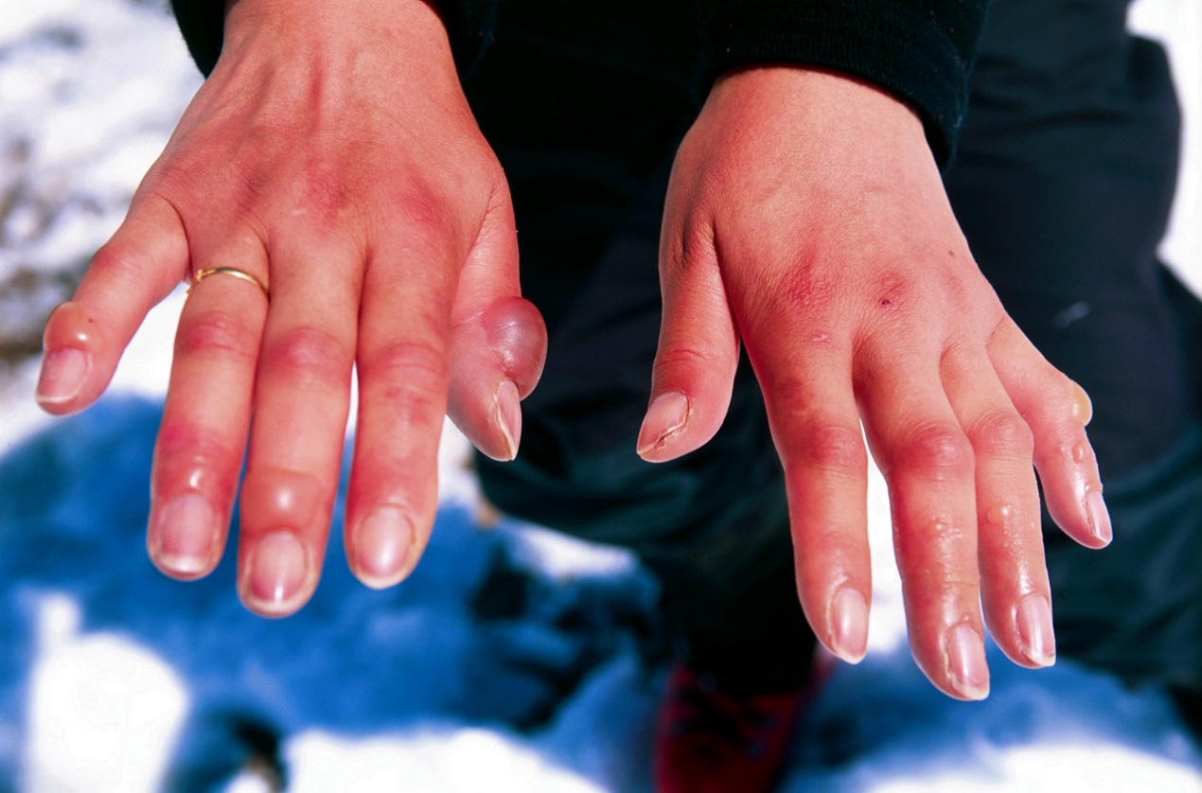
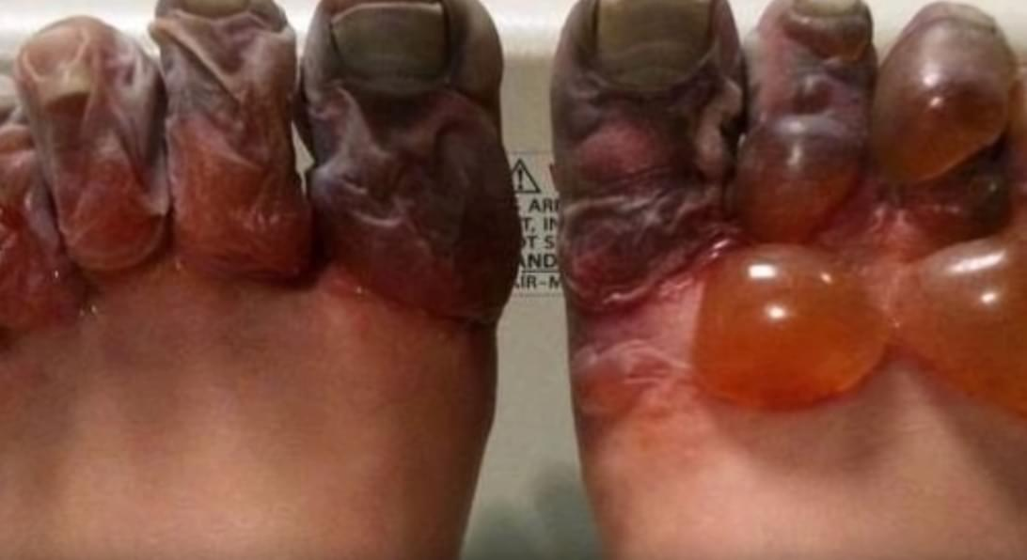
Frostbite

Slide 12
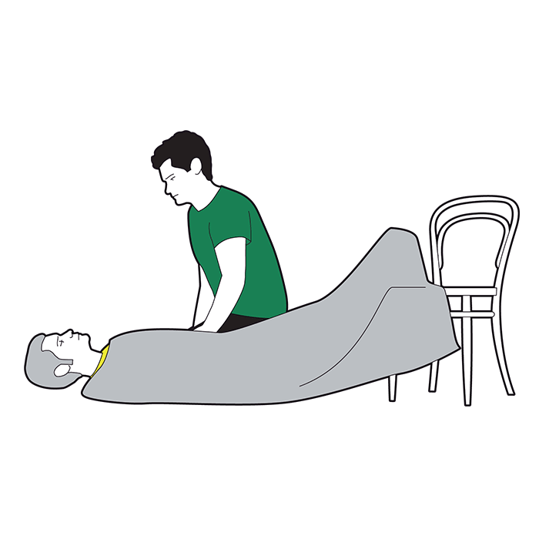
Shock
Lay the Person Down, if Possible. Elevate the person's feet about 12 inches unless head, neck, or back is injured or you suspect broken hip or leg bones. ...
Begin CPR, if Necessary. If the person is not breathing or breathing seems dangerously weak: ...
Treat Obvious Injuries.
Keep Person Warm and Comfortable.

Slide 13

Dehydration

Slide 14
Dehydration
Dehydration occurs when your body loses too much fluid. This can happen when you stop drinking water or lose large amounts of fluid through diarrhea, vomiting, sweating, or exercise. Not drinking enough fluids can cause muscle cramps. You may feel faint. Usually your body can reabsorb fluid from your blood and other body tissues. But by the time you become severely dehydrated, you no longer have enough fluid in your body to get blood to your organs, and you may go into shock, which is a life-threatening condition.
If you become mildly to moderately dehydrated while working outside or exercising:
  Stop your activity and rest.
  Get out of direct sunlight and lie down in a cool spot, such as in the shade or an air-conditioned area.
  Prop up your feet.
  Take off any extra clothes.
  Drink a rehydration drink, water, juice, or sports drink to replace fluids and minerals. Drink 2 qt of cool liquids over the next 2 to 4 hours. You should drink at least 10 glasses of liquid a day to replace lost fluids.

Slide 15
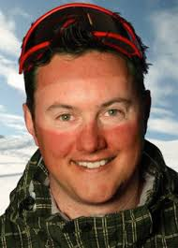
Sunburn
When you get a sunburn, your skin turns red and hurts. If the burn is severe, you can develop swelling and sunburn blisters. You may even feel like you have the flu -- feverish, with chills, nausea, headache, and weakness. It is important to wear sunblock when in the sun, such as at the beach or when skiing. Keep it with you so it can be reapplied throughout the day.
Prevention is the key.

Slide 16
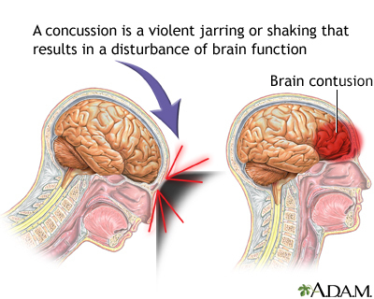
Concussion
Immediately stop the activity.
Monitor the person for changes in symptoms.
  Symptoms can include headaches and trouble with concentration, memory, balance, mood and sleep.
Keep them calm and quiet.
Seek medical evaluation if symptoms persist or worsen.

Slide 17
Fractures
Symptoms of fractures include:
  Severe pain
  Difficulty in movement
  Swelling/ bruising / bleeding
  Deformity / abnormal twist of limb
  Tenderness on applying pressure
For open fractures
  Control bleeding before treatment
  Rinse and dress the wound
For open / closed fractures
  Immobilize the affected area
  Apply ice to reduce pain / swelling
  Consult a doctor

Slide 18
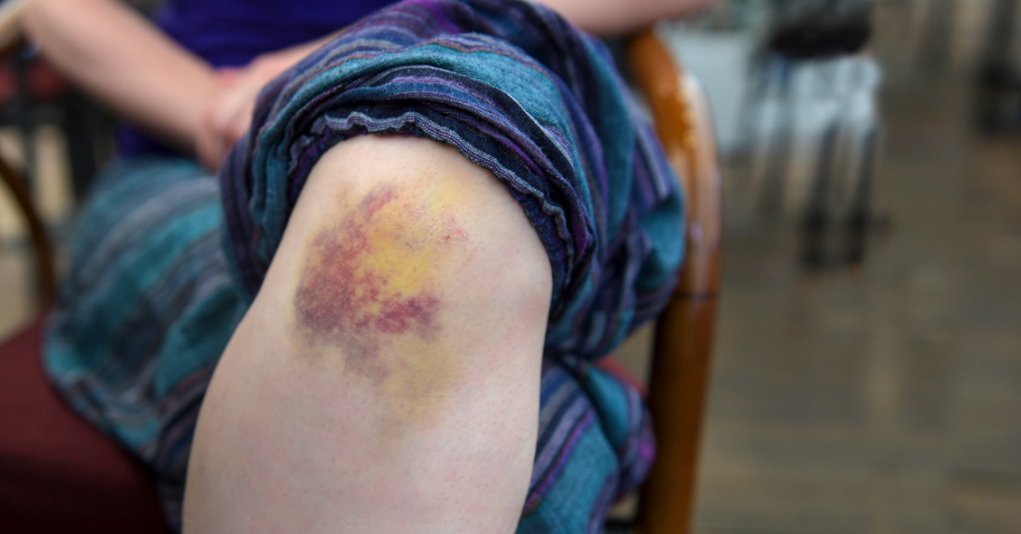
Bruises
Reduce Bruising and Swelling
  Ice the area on and off for the first 24-48 hours.
  Apply ice for about 15 minutes at a time, and always put something like a towel or wash cloth between the ice and your skin.
  Rest the affected area.
  If possible, elevate the affected area.
Treat Symptoms
  For pain, take acetaminophen (Tylenol). Avoid aspirin or ibuprofen (Advil, Motrin), which

Slide 19
Sprains and Strains
To treat sprains, follow the instructions for R.I.C.E.
Rest the injured limb. Your doctor may recommend not putting any weight on the injured area for 48 hours. But don't avoid all activity. Even with an ankle sprain, you can usually still exercise other muscles to minimize deconditioning. For example, you can use an exercise bicycle with arm exercise handles, working both your arms and the uninjured leg while resting the injured ankle on another part of the bike.
Ice the area. Use a cold pack, a slush bath or a compression sleeve filled with cold water to help limit swelling after an injury. Try to ice the area as soon as possible after the injury and continue to ice it for 15 to 20 minutes, four to eight times a day, for the first 48 hours or until swelling improves. If you use ice, be careful not to use it too long, as this could cause tissue damage.
Compress the area with an elastic wrap or bandage. Compressive wraps or sleeves made from elastic or neoprene are best.
Elevate the injured limb above your heart whenever possible to help prevent or limit swelling.

Slide 20
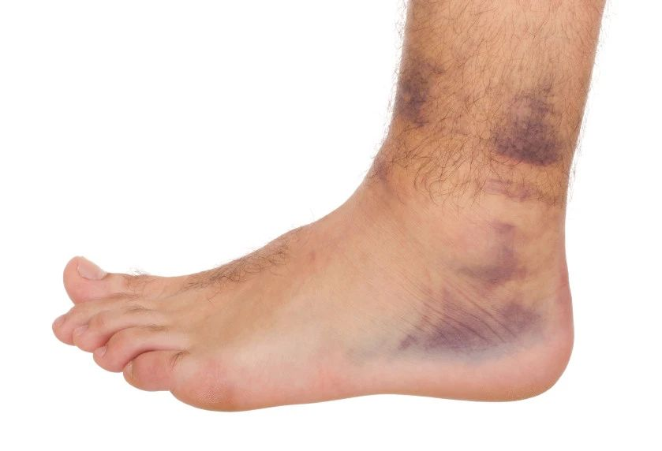
Sprains and Strains

Slide 21
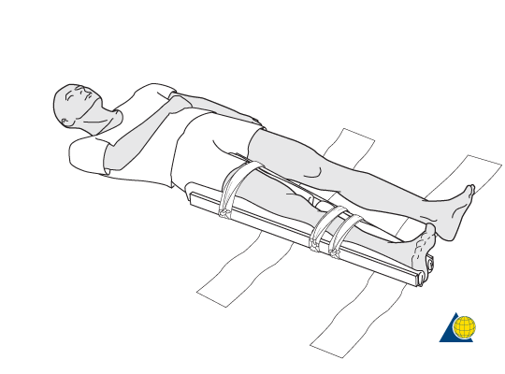
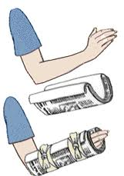
Applying Splints
Applying a Splint
Find a rigid straight object that is longer than the bone and joint that you are going to support. You are going to be using this as the splint.
Cover any broken skin with a sterile cloth. Pad the splint with softer materials such as cloth.
Tie the splint to the injured limb using tape or rope. Make sure the splint is tight but not so tight that it cuts of blood circulation of the victim. Make sure the splint is applied in a way that prevents the limb from further movement or strain.
If available, place an ice bag over the splinted break area. Do not place it directly on the skin or wound but cover it with cloth.

Slide 22
Explain why every skier should be prepared to render first aid
Every skier should be ready to render first aid because there may not be a ski patrol available immediately. When you ski with a buddy or a group, you can render first aid until emergency service arrives. With some injuries every second can count and it is important to know what will help and what will further hurt an injured skier.

Slide 23
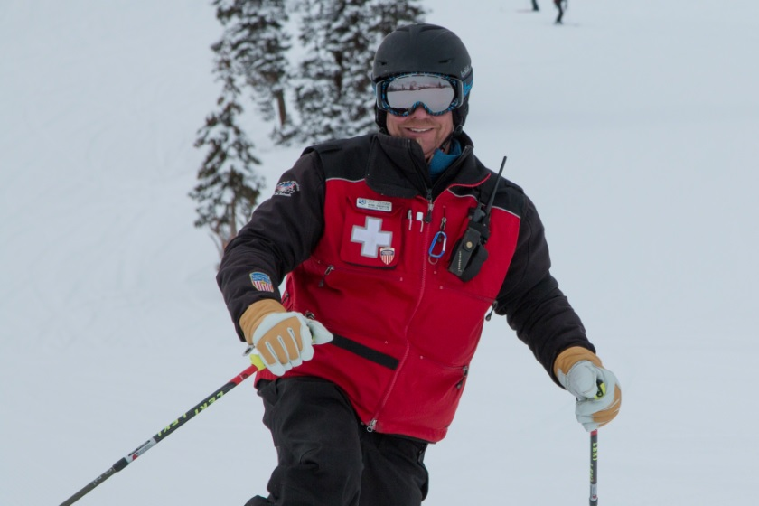
How to report an accident to the ski patrol
Use a cell phone or ask for help from nearby skiers. Cross ski poles.
Nature of the emergency
Location of the emergency
If calling from a phone, phone number where you are calling from
Remain calm, speak clearly and answer all questions

Slide 24
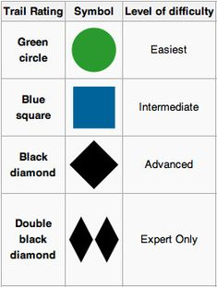
Trail Marking System
Green Circle = easiest
Blue Square = intermediate
Black Diamond = expert
Double Black Diamond = most difficult of all.
The catch is, the difficulty ratings are only meant in comparison to other trails AT THE SAME RESORT. So a blue square in the midwest could possibly be easier than a green circle in the Rockies.

Slide 25
Strength, Endurance, Flexibility
What makes skiing such a great exercise is that is uses all of your muscle groups. However, some muscles are used more than others. Those are the ones you want to concentrate on when it comes to your strength workouts.
Most of us hit the slopes and plan on skiing all day, even if it's been months or years since we last skied. Without proper endurance, by afternoon, you're so tired that your legs feel like jello, a prime time for injuries and accidents happen.
Flexibility is important to avoid injuries when you are skiing. It is important to do some stretching before and after each day of skiing.

Slide 26
Skiing Exercises
Endurance exercises include:
  3 to 5 days each week of your favorite activity. The best for skiing include running, the stairmaster, step aerobics, elliptical trainer and rollerblading.
Strengthening and stretching exercises involve:
  Quadriceps. Probably the most used muscle in skiing are the muscles of the quads. These muscles hold you in position as you ski and they also provide protection for your knees. Great exercises for the quads include squats and lunges.
Because your knees are bent as you ski, your calves (specifically the soleus) help you stay upright so you don't fall over (your ski boots help too). You can or machine calf raises.

Slide 27
Clothing and Equipment
Having the proper clothing is essential for having a blast in the snow.
Base Layer: Wear a synthetic layer, long sleeves or short sleeves, both works. This is to keep you dry and when you sweat, it won’t stay in and make you cold, wet
2nd Layer: Wear a fleece jacket. This will preserve body and keep you warm.
Outer Shell: Wear a snow jacket. This will keep you warm and dry
Head Gear:
  Helmet – protects you from breaking your skull and some other head injuries.
  Ski Mask – protects your face from the cold wind and keep your face dry.
Eye Gear: Ski Goggles or Sunglasses – this is to protect your eyes from the sun reflecting off the snow. Also, it helps keep snow out of your eyes.
Hand Gear: Gloves – to keep your hand from frostbite.
Feet Gear: Ski Socks – to protect your foot from injuries and to keep your feet warm.

Slide 28
Responsibility Code
Regardless of how you decide to enjoy the slopes, always show courtesy to others and be aware that there are elements of risk in skiing that common sense and personal awareness can help reduce. Observe the code listed below, and share with other skiers and riders the responsibility for a great skiing experience.
  Always stay in control, and be able to stop or avoid other people or objects.
  People ahead of you have the right of way. It is your responsibility to avoid them.
  You must not stop where you obstruct a trail, or are not visible from above.
  Whenever starting downhill or merging into a trail, look uphill and yield to others.
  Always use devices to help prevent runaway equipment.
  Observe all posted signs and warnings. Keep off closed trails and out of closed areas.
  Prior to using any lift, you must have the knowledge and ability to load, ride and unload safely.
  Know the code. It's your responsibility.

Slide 29
Smart Style Safety
There are four main messages that are associated with Smart Style:
Make a Plan Every time you use freestyle terrain, make a plan for each feature you want to use. Your speed, approach and take off will directly affect your maneuver and landing
Look Before You Leap Scope around the jumps first, not over them. Know your landings are clear and clear yourself out of the landing area.
Easy Style It Start small and work your way up. (Inverted aerials not recommended).
Respect Gets Respect From the lift line through the park.

Slide 30
Avalanche Safety
Before You Go....
Take an avalanche safety course or clinic. These educational opportunities provide invaluable hands-on experience in personal safety and rescue techniques. (The National Ski Patrol offers excellent Basic Avalanche and Advanced Avalanche Courses for a minimal fee.)
Read up on avalanches. Supplement what you’ve learned in the courses by devouring as much additional information as you can. It’s important to maintain a healthy respect for these deadly forces of nature, no matter how experienced you are at backcountry skiing or snowboarding.
Learn to recognize avalanche terrain. Most avalanches travel in paths, on smooth exposed slopes of between 25 and 60 degrees, but there are many exceptions. To make an informed assessment of avalanche danger, it’s essential to understand the significance of various terrain features, including slope angles, rocks, cornices and other wind-snow formations, ledges, and vegetation. This takes experience, preferably in the company of a guide or instructor.
Practice searching for your companions' avalanche transceivers. Rehearse this until everyone you’ll be traveling with feels confident about his or her ability to locate each beacon as quickly as possible. It takes only one incident to realize the importance of this level of preparation.
Do your homework. Research your route and snow conditions in the exact location(s) you plan to ski. Call your local avalanche warning center and check the current and forecasted weather before heading into the backcountry. Be prepared to adjust plans and/or routes accordingly.

Slide 31
Avalanche Safety
Once You're There....
Always carry avalanche equipment, including avalanche transceivers, probes, and shovels (in addition to basic camping gear, extra clothing, high-energy food, and plenty of water). Every member of the group needs to carry all three of these avalanche rescue items, and know how to use them.
Be aware of your surroundings. Stay alert, and constantly be on the lookout for information about the environment that indicates the potential for a slide. This includes recent avalanche activity and changes in terrain, snowpack, and the weather.
Analyze the snowpack stability. As with studying terrain features, reading the snowpack takes years of experience. There are however, several tests that reveal the layers in the snow and can help you assess risks involved with unstable snow. These include ski-pole tests, snowpit tests, resistance tests, and "shear“ tests. In the National Ski Patrol’s avalanche courses, students learn how to conduct these tests and have the opportunity to see the snowpack firsthand.
Cross potential avalanche slopes one at a time. If you doubt a slope's stability but still intend to cross it, only expose one person at a time to the potential for danger. When climbing or traversing, each person should be at least 100 yards from the next person. Travelers should climb steep narrow chutes one at a time, and when descending the slope, ski it alone. This not only minimizes the number of people who might get caught (and maximizes the number of people available for rescue), but it also reduces the stress put on the snowpack.

Slide 32
Avalanche Safety
General rules of the road....
Don't overlook clues. Evidence of potential avalanche hazards will be there, so pay attention. If you educate yourself and communicate with your companions, you should have the tools needed to make smart decisions in the backcountry.
Try to avoid traveling in the backcountry alone. Also, never leave the group. Otherwise, if you run into trouble, you'll be on your own.
Don't assume avalanches occur only in obvious large paths. While most slides travel on broad, steep, and smooth slopes, they can also wind down gullies or through forested areas. Remember, if you can ski or snowboard through it, an avalanche can slide through it.
Never travel in the backcountry on the day after a big storm. Allow the snowpack to settle for at least 24 hours.
Don't assume a slope is safe because there are tracks going across it. Wind, sun, and temperature changes are constantly altering snowpack stability. What was safe yesterday (or this morning) could slide this afternoon. Further, when you cross a slope, you apply stress to the snowpack, which can cause it to slide.
Don't allow your judgment to be clouded by the desire to ride the steepest pitch or get the freshest snow. Staying alive is much more important.
Don't hesitate to voice concerns or fears. No one is going to criticize you for wanting to be safe in the backcountry.

Slide 33
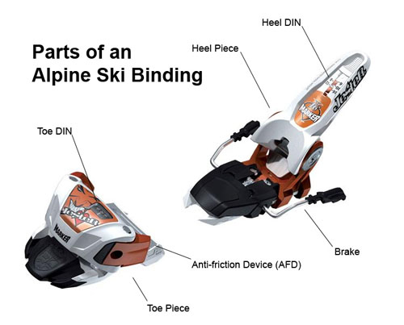
Alpine Bindings
The vast majority of bindings for Alpine skiing work by fixing the ski boot to the ski at the toe and heel. The binding attaches the boot to the ski, but to reduce injury also allows the boot to release in case of a fall. Generally, the toe piece is designed to allow the boot to rotate to the sides, while the heel piece rotates up. In modern bindings a wide variety of motions is available from both toe and heel pieces.

Slide 34
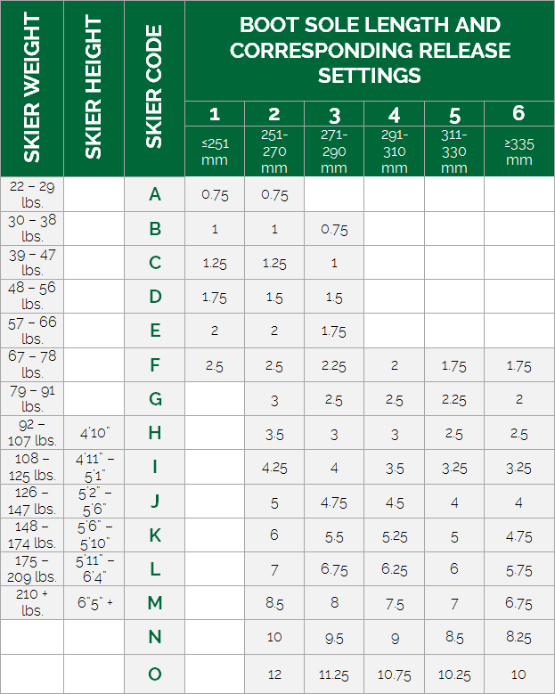
Alpine Bindings
The boot is released by the binding if a certain amount of torque is applied, usually created by the weight of a falling skier.
  The amount of torque required to release the boot is adjusted by turning a screw on the toe and heel piece.
  This is called (colloquially) the DIN setting, because the standards for Alpine ski binding settings are issued by Deutsches Institut für Normung.
  The correct DIN setting is based on height, weight, ski boot sole length, the skiing style of the skier (cautious, average, or aggressive) and, age (if the skier is younger than 10 years old, or 50 years old or older).

Slide 35
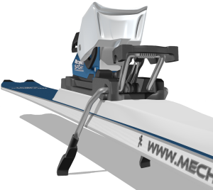
Alpine Bindings
Alpine ski bindings employ the use of a snow brake to prevent the ski from moving while it is not attached to a boot. Snow brakes work by the use of a sprung square 'C‘ shape, typically made of metal, which makes contact with the snow. When a ski boot is put in the ski binding, the brake pivots under the downward pressure and runs parallel with the ski allowing free movement. When the boot comes out of the ski, the brakes spring out perpendicular to the ski and stop the ski from sliding.

Slide 36
Basic Ski Bindings Maintenance
Your ski bindings maintenance plan should begin at the start of the season. Bring your bindings to a well-respected ski shop, and have them checked for common defects, which include broken parts and loose screws. Additionally, if you have purchased new ski boots or skis, you will need to check the compatibility between your boots, skis and bindings.
The anti-friction device plate should also be checked for damage. It is easily replaceable, as long as you catch the damage before it becomes severe. Most experts suggest that your DIN setting should be lowered when you reach the age of 50. On the other hand, if you are starting to ski in more challenging terrain, you might want to take your bindings to the shop and have them adjusted to a higher DIN setting.

Slide 37
Keep Bindings Clean and Dry
Remember to dry your bindings after each use in order to prevent the build up of dirt and grime.
If you keep your bindings on your vehicle's ski rack, be sure to invest in a pair of binding covers.
Many experts suggest that twice a year you grease the heel piece of your binding, and some suggest that you lower your DIN setting for summer storage.
During the off-season, be sure to store your skis in a warm, dry place.

Slide 38
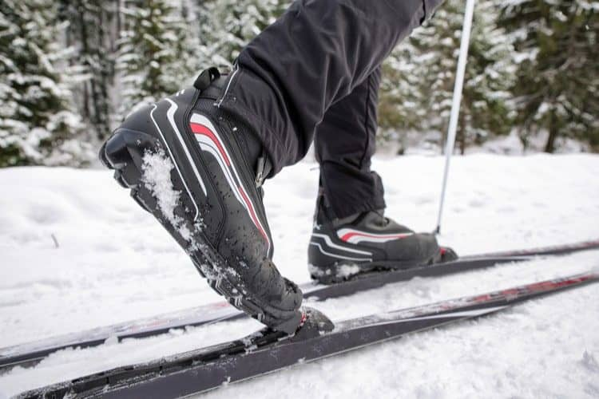
Cross Country Bindings
A bar in the toe of the shoe is hooked into a catch in the binding.

Slide 39
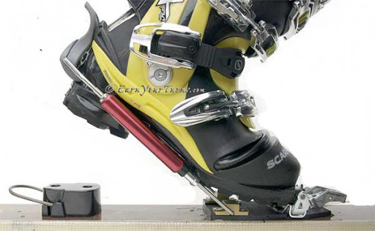
Telemark Bindings
Like Nordic bindings, Telemark bindings fix only the toe leaving the heel free to move.
The main difference is that Telemark bindings are more heavy-duty to withstand the increased forces encountered in high speed descents.
The toe section of the boot is anchored, and an adjustable cable around the heel (for which there is a groove in the heel of the shoe) secures the boot.

Slide 40
American Teaching System
The basic teaching progression starts a student with balancing on a moving ski on a flat area and progresses to 2 skis, making a wedge turn in each direction, and stopping by turning uphill by stepping out of the position.
Once the student can turn both ways and stop on command on a gentle slope, edging of the skis by side stepping up and downhill and climbing with a herringbone maneuver is introduced and the skill is developed to let the student climb and slide on a gentle slope.
At this point the student is shown how to ride and unload from a beginners lift, the next stage is to ski a great deal and to practice the 3 skills they have been shown and to learn about pressuring the ski edge.
This initial lesson can usually be taught in about 1.5 hours in many ski resorts. The next lesson will involve more skiing, and some new turns to help the student to become a good skier.

Slide 41
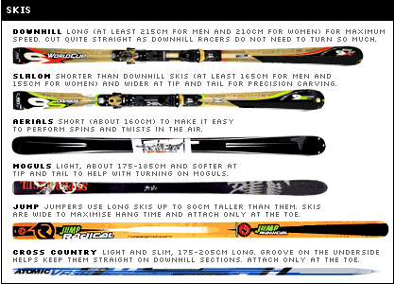
Types of Alpine Skis

Slide 42
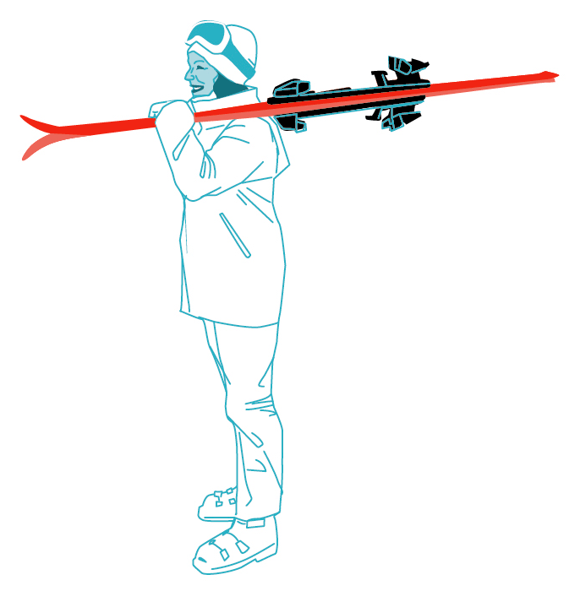
How to Carry Your Skis

Slide 43
Demonstrate how to ride one kind of lift and explain how to ride two others.
How to Ride a Ski Lift Video

Slide 44
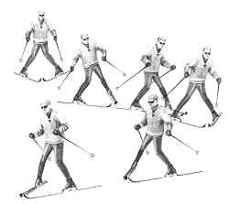
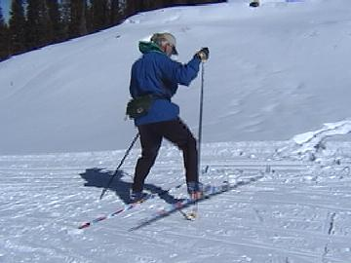
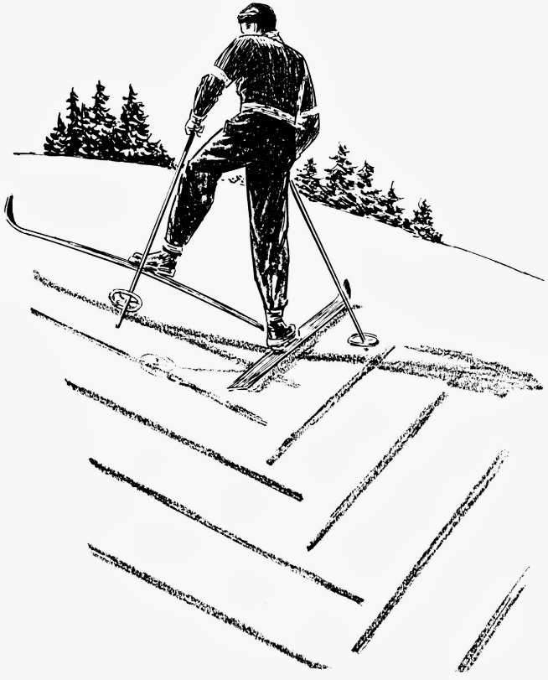
Demonstrate While Skiing
On a gentle slope, demonstrate some of the beginning maneuvers learned in skiing:
  straight run
  gliding wedge
  wedge stop
  Sidestep
  Herringbone
On slightly steeper terrain, show linked wedge turns.

Slide 45
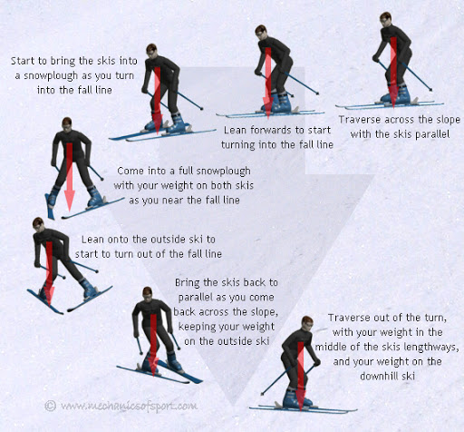
Demonstrate While Skiing
On a moderate slope, demonstrate five to 10 christies.
  The stem christie or "wedge christie" is a technique used in skiing for turning. The turn comprises three steps:
    Forming a wedge by rotating the tail of one ski outwards at an angle to the direction of movement, which initiates a change in direction opposite to the stemmed ski.
    Bringing the other ski parallel to the wedged ski.
    Completing the turn with both skis parallel as they carve an arcing turn sliding sideways together.
Stem Christie video

Slide 46
Demonstrate While Skiing
Make a controlled run down an intermediate slope and demonstrate the following:
  Short-, medium-, and long-radius parallel turns
    Parallel turn video
  A sideslip and safety (hockey) stop to each side
    Side slip video
    Hockey stop video
Traverse across a slope
Demonstrate the ability to ski in varied conditions, including changes in pitch, snow conditions, and moguls. Maintain your balance and ability to turn.

Slide 47

USSA
• The U.S. Ski and Snowboard Association (USSA) is the national governing body of Olympic skiing and snowboarding. It is the parent organization of the U.S. Ski Team, U.S. Snowboarding and U.S. Freeskiing. Developed to facilitate participation in national and international competition, the Olympic sports organization provides structure for competitive skiing and snowboarding. From grassroots programs to governance of sport, management of rules, competitions and athletic rankings, the USSA oversees athletic pipelines for development in the sports. With a vision to make the USA the best in the world in Olympic skiing and snowboarding, the USSA provides leadership and direction for tens of thousands of young skiers.

Slide 48

PSIA-AASI
The Professional Ski Instructors of America and American Association of Snowboard Instructors (PSIA-AASI) is the world’s largest nonprofit education association dedicated to promoting the sports of skiing and snowboarding through instruction. With more than 31,500 members instructing at 300 member ski and snowboard schools, PSIAAASI establishes certification standards for snowsports instructors and develops education materials to be used as the core components of instructor training.

Slide 49

NSP
As the leading authority of on-mountain safety, the National Ski Patrol (NSP) is dedicated to serving the public and outdoor recreation industry by providing education and accreditation to emergency care and safety service providers. The organization is made up of more than 28,000 members serving over 650 patrols, including alpine, Nordic, and auxiliary patrollers. The members work on behalf of local ski and snowboard areas to improve the overall experience for outdoor recreationalists.

Slide 50

NASTAR
NAtional STandard Race is the largest public grassroots ski race program in the world. Participants compete within their age and gender groups to win platinum, gold, silver and bronze medals. In addition, participants are ranked in their medal group and the top ranked racers qualify to compete in the Nature Valley NASTAR National Championships.
The NASTAR handicap system is a standardized scoring program that provides participants with a tangible number that represents their ability. The NASTAR.com web site records each participants stats and ranks each racer at the host resort, in their state of residence and nationally.

